Slide 1


Diagnosis of Breast Cancer
By Zack DeNoto
https://www.gvec.org/wp-content/uploads/2019/10/Breast-Cancer-Awareness-Month-2019.jpg

Slide 2
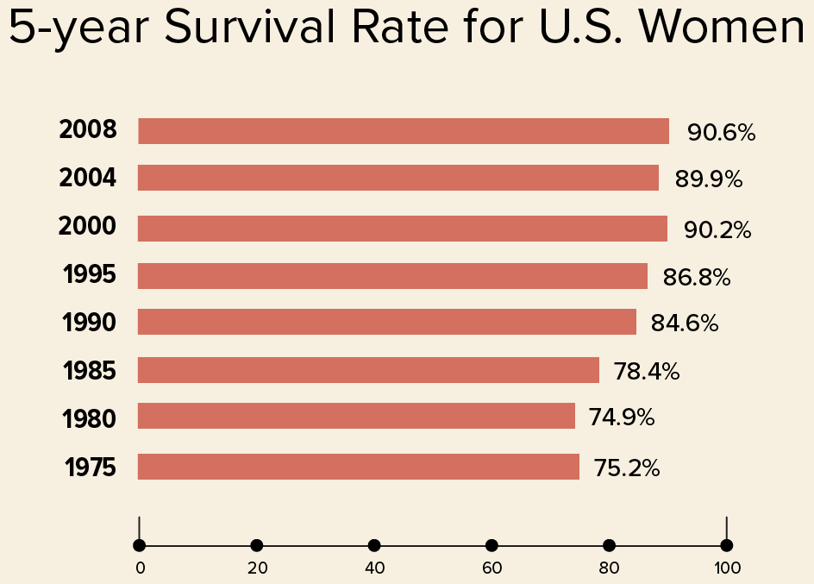
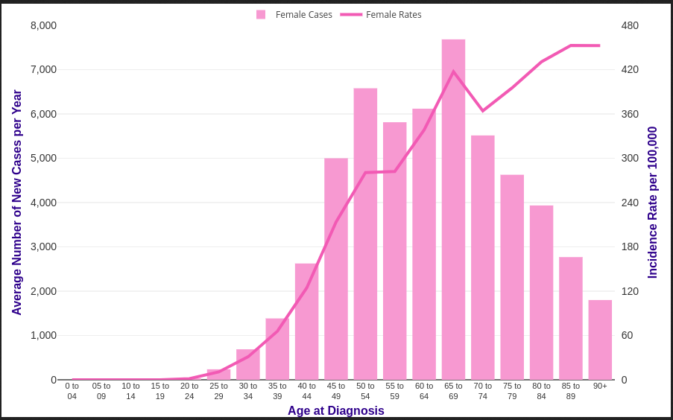
Intro/Hypothesis
Cancer and Breast Cancer
Biggest Factors
Can we predict diagnosis?

Slide 3
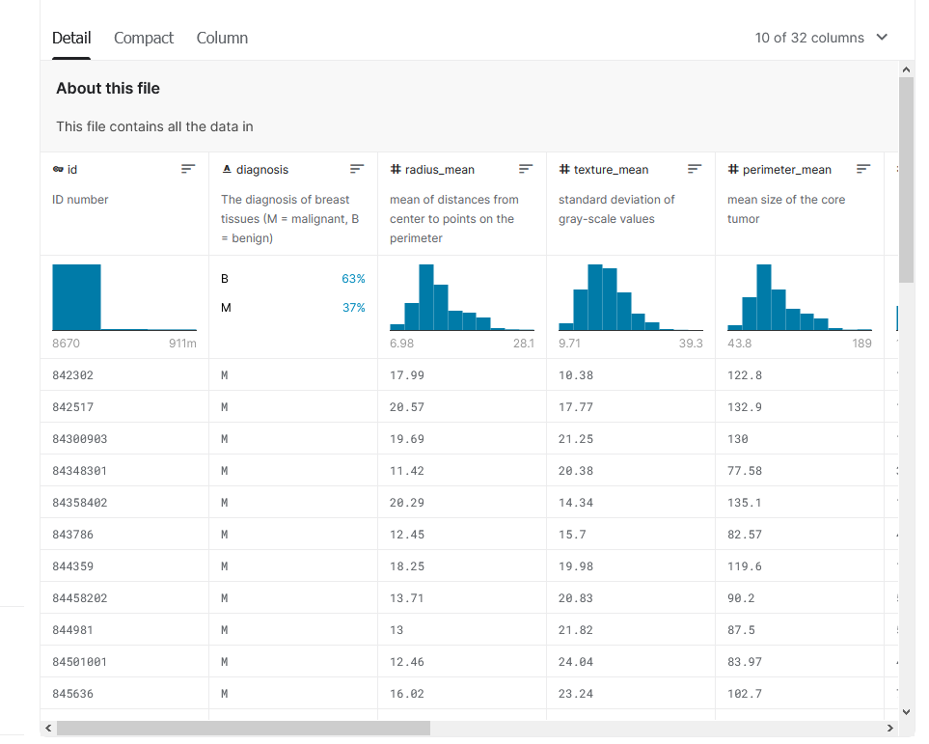
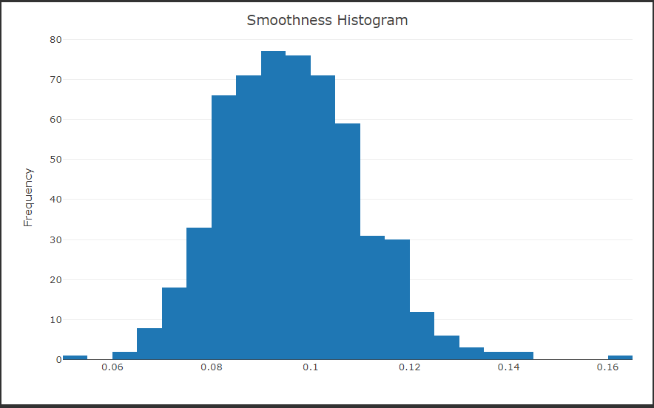
EDA
Dataset
Steps needing to be done
Challenges

Slide 4
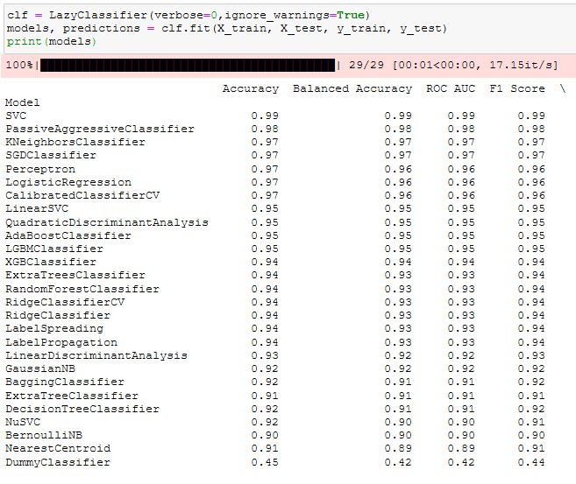
Modeling
Lazy Predict
K-Nearest Neighbor
Random Forest
Logistic Regression
XGBoost
Stochastic Gradient Descent

Slide 5
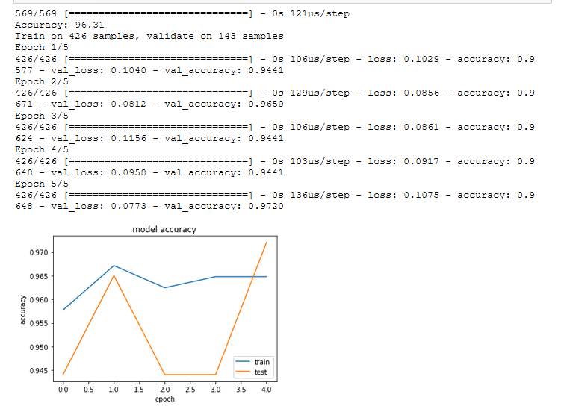
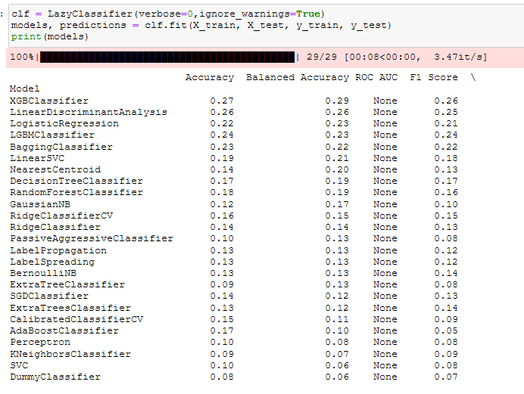
Modeling
Notes:
Texture mean on the right
Deep learning keras model for

Slide 6
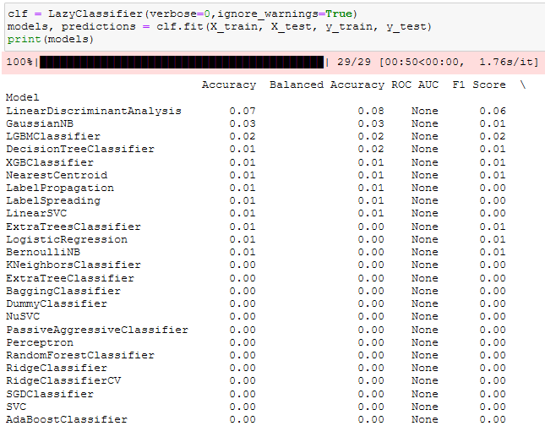
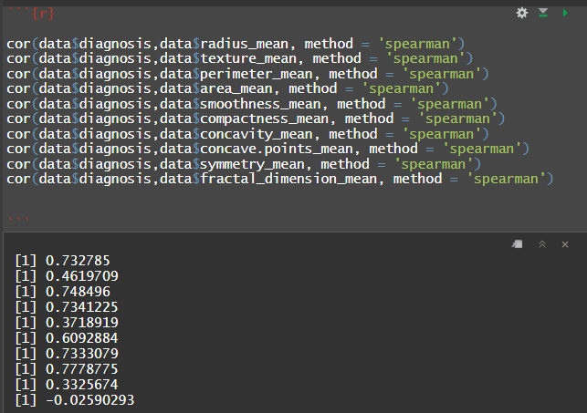
Results
Accuracy
Correlation
Factors

Slide 7


Conclusion
How can this analysis be
improved?
How does this impact the field?
Other studies

